Slide 1
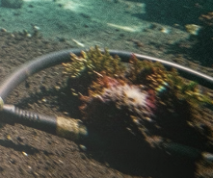
UNDERWATER ACOUSTIC SENSOR NETWORKS
AQUAROS
PLUS
Content-Aware Priority Scheduling for Underwater Acoustic Sensor Networks
A lightweight intelligence layer that prioritizes messages by what the sensor reports, not only by sensor type.

Slide 2

Critical messages can be delayed
Underwater sensor networks collect pressure, temperature, and hydrophone readings. These readings travel over bandwidth-constrained acoustic links with high latency and possible interruptions.
When communication is available, only a limited number of buffered messages can be transmitted in each communication window.
Pressure 6 bar: normal. Pressure 40 bar: potentially serious anomaly.
Both readings may receive the same priority in the existing system, because priority is assigned by sensor type rather than reading value.
Consequences:
Routine messages from a higher-priority sensor type may be transmitted first.
Critical anomalies from a lower-priority sensor type may wait across multiple communication windows.
Delayed warnings reduce the usefulness of time-sensitive sensor information.
Problem: the existing priority mechanism considers which sensor sent the message, but does not evaluate how serious the reported condition is.
02
Notes:
Both readings can receive the same sensor-type priority in the existing system. The issue is that priority considers which sensor sent the message, not how serious the reported condition is.

Slide 3

RESEARCH GAP
Existing fixed-priority path
Fixed priorities leave a research gap
Sensor reading
Identify sensor type
Assign fixed priority
Priority queue
Transmission
Related research addresses underwater routing, energy efficiency, packet scheduling, and queue management. AQUAROS PLUS specifically focuses on calculating message urgency from the actual sensor reading.
No content awareness: normal and abnormal readings from one sensor share a base priority.
Delayed anomalies: routine messages can consume limited transmission opportunities.
Manual configuration: priority tables need deployment-specific tuning.
BASE PRIORITY
Sensor type | Example base priority
Hydrophone | 8
Temperature | 2
Pressure | 2
03

Slide 4
THE PROPOSED LAYER
AQUAROS PLUS adds intelligence before the queue
AQUAROS PLUS
Sensor reading
Normal-range check
Deviation and severity calculation
Updated priority
Priority queue
Transmission
Normal readings retain their base priority.
Out-of-range readings receive a severity-based boost.
Final priority is capped at 10.
Higher-priority messages get earlier access to available capacity.
Intelligence before the queue.
ARCHITECTURE PRESERVED
Existing: sensor type → priority. AQUAROS PLUS: sensor type + reading severity → priority.
AQUAROS PLUS adds a content-aware layer before the existing priority queue. It does not replace the entire communication system or redesign the MAC and modem layers.
04

Slide 5
PRESSURE SCORING EXAMPLE
LOCAL SCORING
Reading | Condition | Final priority
6 bar | Normal | 2
12 bar | Abnormal | 8.8
40 bar | Severe anomaly | 10
Severity scoring turns readings into urgency
Read the sensor value.
Compare it with the sensor's configured normal operating range.
If it is within range, retain the base priority.
If it is outside the range, calculate the normalized deviation and severity boost.
Calculate the final priority, capped at 10.
If value is within range:
Otherwise:
Scoring is O(1) per reading; ordering n buffered messages with comparison sorting is O(n log n).
EXAMPLE RANGE · 0–10 BAR · BASE PRIORITY 2
05

Slide 6

MODEL STATUS
QLS and SHEEP are simplified models inspired by the cited papers, not exact reimplementations.
SYSTEM INTEGRATION
Integrated path: routing, urgency, queue, modem
Sensor nodes → SHEEP-inspired routing → AQUAROS PLUS → QLS-inspired queue management → ros_acomms MAC and modem → sink.
ROLES
SHEEP-inspired routing: selects the next relay based on residual energy in the simulation.
AQUAROS PLUS: evaluates the actual sensor reading and adjusts message priority.
QLS-inspired queue management: represents queue and energy management.
ros_acomms: represents the existing communication, MAC, and modem interface.
Sensor Nodes
Routing Relay
Priority Eval
Queue & MAC
RELATED RESEARCH
Caroline Mary, A., Senthil Kumar, A.V., Saleh, O.S. (2024). “Packet Scheduling in the Underwater Network Using Active Priority and QLS-Based Energy-Efficient Backpressure Technique.” Lecture Notes in Networks and Systems, vol. 731, Springer. DOI: https://doi.org/10.1007/978-981-99-4071-4_39
Ismail, M. et al. (2023). “A Novel Routing Protocol for Underwater Wireless Sensor Networks Based on Shifted Energy Efficiency and Priority (SHEEP).” Computer Communications, vol. 210, pp. 147–162. DOI: https://doi.org/10.1016/j.comcom.2023.07.014
MODEL STATUS
QLS and SHEEP in this project are simplified models inspired by the papers, not exact reimplementations.
06

Slide 7





IMPLEMENTATION
Software simulation setup
Implemented: aquaros_project.py for the priority algorithm, two-hop network simulation, and evaluation metrics.
Interactive demo: aquaros_plus_demo.html with two queues, capacity-limited communication windows, live reading injection, and auto-demo mode.
Tests and outputs: seven automated tests; ROS wrapper node written but not tested; results/results.csv and results/summary.png; written project documentation.
Relays
Sensors
Simulation configuration:
Sink
6 sensor nodes, 2 relay nodes, 1 sink.
Each sensor generates 4 readings per communication window and can send 4 messages.
Each relay can forward 12 messages per window.
Transmission loss probability: 10%. Anomaly probability: 3% per reading.
200 windows per run; results averaged across 40 random seeds.
Relay selection based on residual energy using a SHEEP-inspired model.
Experiment
Boundary: software simulation only. No physical underwater hardware or live ros_acomms integration was used.
07

Slide 8
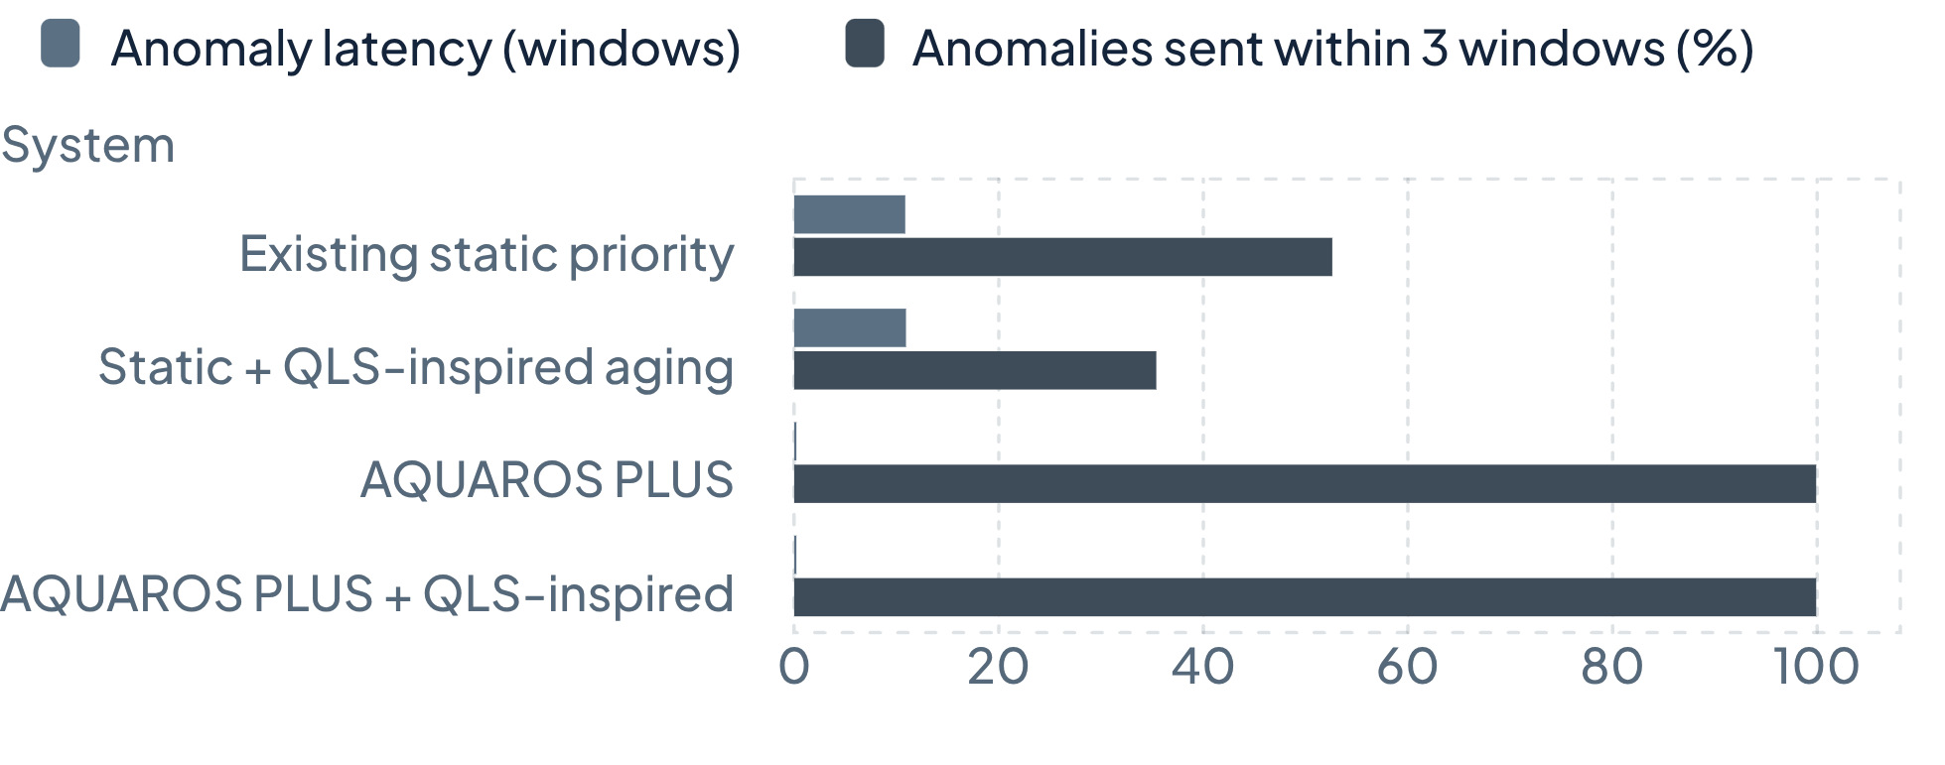
SOFTWARE SIMULATION · AVERAGES ACROSS 40 RANDOM SEEDS
AQUAROS PLUS sharply reduces anomaly delay
RESULTS
98%
Average anomaly latency falls approximately 98%.
Anomaly p95 latency: 37.7 windows existing vs 1.0 window AQUAROS PLUS.
Anomaly delivery ratio: 89.2% existing vs 99.9% AQUAROS PLUS.
Routine latency rises slightly from 11.05 to 11.39 windows.
SYSTEM | ANOMALY LATENCY (WINDOWS) | ANOMALIES WITHIN 3 WINDOWS | ROUTINE LATENCY (WINDOWS)
Existing static priority | 10.86 | 52.6% | 11.05
Static + QLS-inspired aging | 10.93 | 35.4% | 11.05
AQUAROS PLUS | 0.22 | 99.9% | 11.39
AQUAROS PLUS + QLS-inspired | 0.22 | 99.9% | 11.39
A window is not treated as a fixed number of seconds.
08

Slide 9
VALIDATION ROADMAP
Limitations define the next validation steps
LIMITATIONS
NEXT VALIDATION STEPS
Simulation only: no physical underwater hardware or live ros_acomms test was performed.
QLS and SHEEP are simplified models inspired by published work, not exact reimplementations.
The ROS wrapper is written but untested.
Sensor ranges are simplified placeholders and require real-world calibration, particularly for hydrophone measurements.
The simulated network is overloaded, so routine latency is high for all systems.
Replay recorded sensor data offline.
Integrate AQUAROS PLUS with ros_acomms in a ROS test environment.
Conduct controlled tank tests using a real acoustic modem.
Evaluate the system in a field deployment.
Measure priority accuracy, computational overhead, routine-traffic impact, critical-message latency, time-critical delivery ratio, and energy consumption.
Local scoring requires no additional network transmissions.
09

Slide 10
SIMULATION RESULTS
TAKEAWAY
Measure | Existing → AQUAROS PLUS
Average anomaly latency | 10.86 → 0.22 windows
Anomalies sent within three windows | 52.6% → 99.9%
Routine latency | 11.05 → 11.39 windows
Content should determine urgency
AQUAROS PLUS introduces content-aware priority scoring before the existing priority queue. It distinguishes routine readings from abnormal readings and boosts the priority of severe anomalies without replacing the underlying communication architecture.
Key results:
References
Caroline Mary, A., Senthil Kumar, A.V., Saleh, O.S. (2024). “Packet Scheduling in the Underwater Network Using Active Priority and QLS-Based Energy-Efficient Backpressure Technique.” Lecture Notes in Networks and Systems, vol. 731, Springer. DOI: https://doi.org/10.1007/978-981-99-4071-4_39
Ismail, M. et al. (2023). “A Novel Routing Protocol for Underwater Wireless Sensor Networks Based on Shifted Energy Efficiency and Priority (SHEEP).” Computer Communications, vol. 210, pp. 147–162. DOI: https://doi.org/10.1016/j.comcom.2023.07.014
Average anomaly latency: 10.86 → 0.22 windows.
Anomalies sent within three windows: 52.6% → 99.9%.
Routine latency: 11.05 → 11.39 windows.
“A message's importance should depend on what the sensor reports, not only on which sensor sends it.”
10

